Slide 1
Super Creation

Slide 2
Symbol
What is a symbol?
The use of symbols to express or represent ideas
Examples?
stop sign, batman, and recycling
How can a costume be a symbol?
Makes a superhero stand out in the community (reveal)
Has attributes that adjust to super powers
Can make normal identity secret if you want

Slide 3
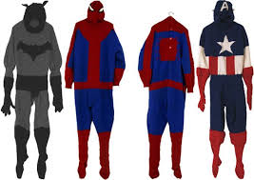
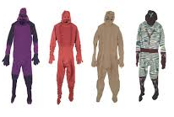
Mark Newport
Fiber Artist
Knits costumes based off of famous superheroes but also makes up his own
Makes them life size and wearable
His costumes combine their heroic, protective, ultra-masculine, yet vulnerable personas

Slide 4
R-Superhero
A-Classroom and the world!
F-Fabric and paper
T-Superhero costume

Slide 5
Parts of a superhero costume

Slide 6
Importance of Color
What type of colors are superhero costumes you know?
Bright (red, yellow, blue)
Dark (black, grey, dark blue)
Why are the colors they use important?
Superman ---
Batman ---
What type of colors should we use for our superpowers?
Primary colors!!

Slide 7
Life size costume plan
Pick a partner
Find a spot in the room to put your giant paper
Take turns with your partner tracing the outline of your partner with a pencil
Use markers and crayons to draw the outline of your superhero’s costume. Use this to help you decide what colors you want to use, where to put your symbol, and the different parts you want. Label the different parts.
You will then pick one part that you are going to make (put a star by it with a yellow marker)
After you have decided what part, show Lisa and you will be able to get materials and start working

Slide 8
Clean up
One student will clean up any extra scraps on the floor
One student will put markers, scissors, and tables materials away
One student will collect all fabric extras and put them back in bin
Everyone help clean up scraps when finished
Once all this is done students will put their sketchbooks in their cubbies and sit in a circle on the carpet

