Slide 1
Artist Statement

Slide 2
Video
We are all heroes

Slide 3
Now that you have become your superhero, chosen a super power, and made a costume you need to let the community know what you are here to do for them. You will record a video that will let your community know who you are, what your powers can do and how you got them, and how you are going to help the community with those powers. Once these videos are recorded they can then be sent out to the community so everyone will know your name and know the good you do for them!

Slide 4
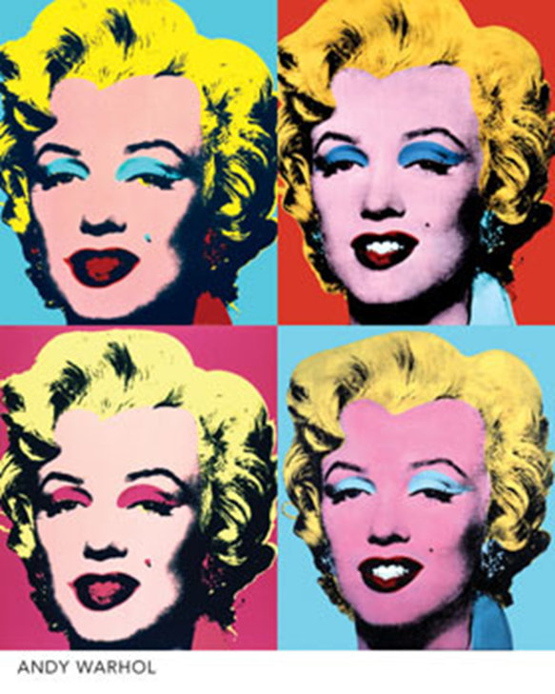
Andy Warhol

Slide 5
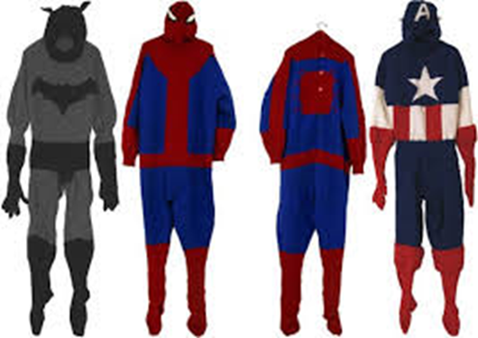
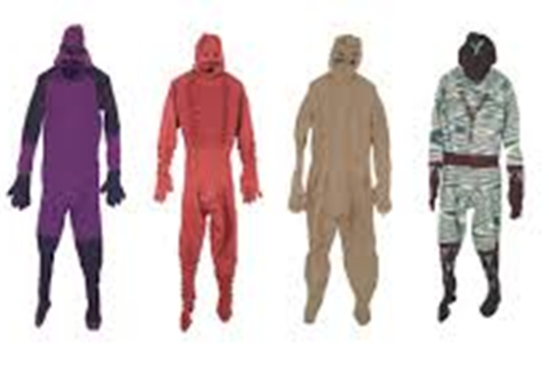
Mark Newport

Slide 6
Artist Statement
What is an artist statement?
Tells meaning behind artist’s intent behind their artwork

Slide 7
Using the video camera
Press red button to start recording and to end the recording.
Make sure to keep your fingers off the speaker (little dots).
You need to make sure to keep the camera steady using the tripod.
If you are recording you need to be quite and not talk.

Slide 8
Work sheet
What is your superhero’s name?
What is your superpower?
Why is this, your superpower?
How does your superpower help the community?
What is your symbol? And why?
How does your costume represent your superhero?

Slide 9
Work time
If your group isn’t recording you need to be creating a drawing in your sketchbook of your superhero using their powers to help the community.
We will be using these next week.

Slide 10
Reflection
What did they like most?
Did they have any problems and what were they?
Does anyone feel like they need more time to record a better video?

