Slide 1
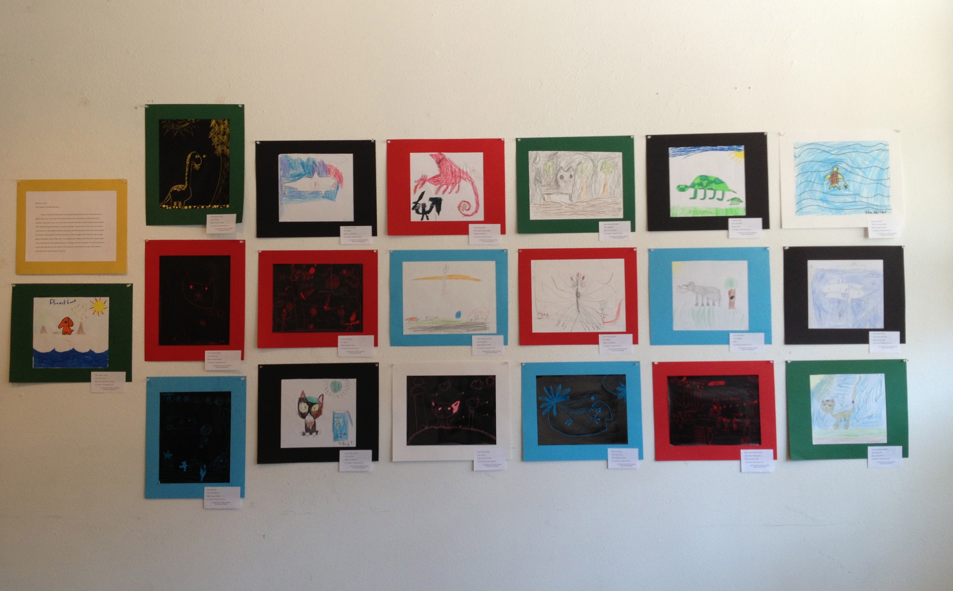
Art Show at the Art Lab
On Saturday the 27th

Slide 2
Super Identity

Slide 3
Review
What is symbolism?
the use of symbols to express or represent ideas
What symbol did you create?

Slide 4
We are all SUPER!!!

Slide 5
R: superhero
A: the world! and your community
F: mono-print
T: superhero symbol

Slide 6
Brainstorming
What are your traits?
What are you good at?
What could your superpower be that helps your community?

Slide 7
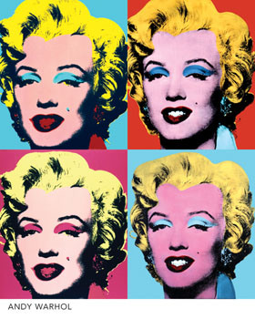
Pop Art Artist:
Andy Warhol
Pop Art uses images and icons that are popular in the modern world
Artists often repeat the item over and over again, changing the color or texture of the item, and putting different items together to make a picture.
1962 silkscreen print of Marilyn Monroe

Slide 8
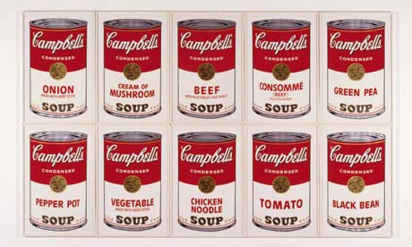
Andy Warhol

Slide 9
Steps to Making a Mono-print:
Draw your symbol
Put the plexi-glass over your drawing
Trace and color your symbol with markers
Wet your paper then pat it dry
Put the paper on top of the plexi-glass, marker side up, and rub with your hands
Peel off carefully
Before making a new print: wash off at the sink and dry it then repeat steps 2-6

Slide 10
If you finish:
Pretend a newspaper reporter saw you doing something good for your community and your drawing is what they saw!
Draw it in your sketchbook

Slide 11
Clean up
one person from each group collects and returns all usable materials
another student collects all markers and puts them away
another student puts away all other materials
all students put their sketchbooks in their cubbies and be seated and quiet with their completed artwork

