Slide 1
Super Fan

Slide 2
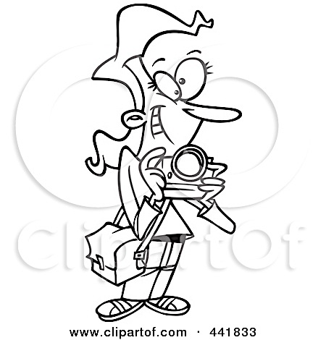
Newspaper Reporter

Slide 3
Today
You work for a newspaper, and you want to include some information in this week’s newspaper about this new superhero that is helping the community. Since pictures are worth a thousand words you are going to create a drawing or painting of your superhero in action, using their superpowers to help the community. You are going to add a caption to the image you create so everyone who looks at the newspaper can learn more about your superhero.

Slide 4
Caption
What is a caption?
Why is it helpful to include a caption with a picture?

Slide 5
Planning and
Drawing time!

Slide 6
Painting
What 2 colors do we use to make green?
Yellow and blue
What 2 colors do we use to make purple?
Red and blue
What 2 colors do we use to make orange?
Yellow and red
How could we make pink?
Red and white
How could we the paint more see though and less thick?
Add water to the paint

Slide 7
Clean up
one student from each table collect all of the paint brushes, put them brush down into a water cup, and bring them to the sink to be washed out.
one student from each table wipe off the extra paint from the palette and wait to bring it to the sink to wash off
all students bring their sketchbooks to Mercedes and leave their painting on their tables for us to collect.
add white to make it lighter, complementary colors, add water to make it less thick and more see-through, proper way on using brush (don’t dip the whole brush in), how to clean the brush in water in between using different colors

Slide 8
Gallery Walk
walk around the room and look at everyone’s painting and read the caption they wrote to go with it
What would you think if you saw this on the cover of a newspaper?

Slide 9
Super Fan

Slide 10
Incredibles clip
http://youtu.be/1LASc8ewLaw
(stop at 0:50)

Slide 11
What did you see in the video clip?
What did he do with all of these articles?
Why do you think he did that?

Slide 12
You are going to pretend you are your superhero’s biggest fan and make a collection of objects/artifacts as tribute to your superhero. You can include a representation of their symbol, a small painting showing their superhero in action with a caption similar to an image in a newspaper article and other objects of your choice that specifically relates to your superhero. We are going to create our own bulletin boards to pin it all on.

Slide 13
Important Words
Artifact:
any object made by humans, often being used a second time
Tribute:
expression of appreciation

Slide 14
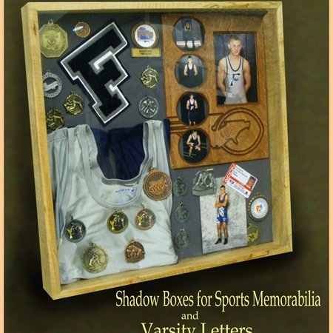
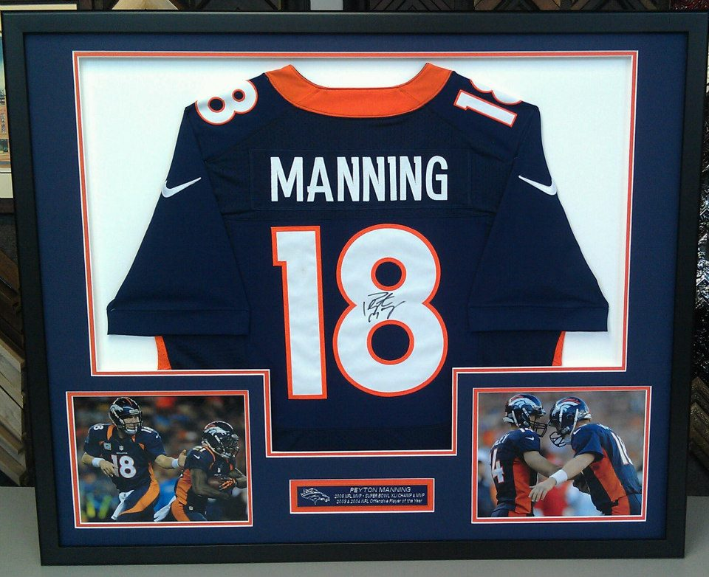
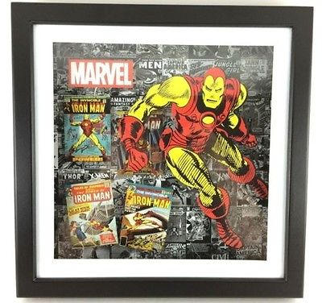

Slide 15
Some ideas of Artifacts to include:
Superhero name
Painting of superhero with caption
Mono-print of symbol
An object relating to your superhero
( for example: a watch for Super Lisa)
A note from a fan
A note from a member of you community you helped

Slide 16
Clean up
Have one student from the paint station collect all of the paint brushes, put them brush down into a water cup, and bring them to the sink to be washed out.
Have one student wipe off the extra paint from the palette and wait to bring it to the sink to wash off
Have all students bring their sketchbooks to Mercedes and leave their painting on their tables for us to collect. Have students clean up all extra materials and leave just their creation and painting at their spot at their color group tables

Slide 17
Gallery Walk

Slide 18
Let’s Celebrate Our Last Day
What was your favorite part of art this semester?
What was you favorite piece of artwork that we created?

