Slide 1
Super Creation

Slide 2
Symbol
What is a symbol?
The use of symbols to express or represent ideas
Examples?
stop sign, batman, and recycling
How can a costume be a symbol?
Makes a superhero stand out in the community (reveal)
Has attributes that adjust to super powers
Can make normal identity secret if you want

Slide 3
Super Suit

Slide 4
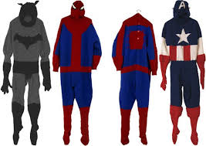
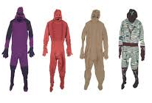
Mark Newport
Fiber Artist
Knits costumes based off of famous superheroes but also makes up his own
Makes them life size and wearable
His costumes combine their heroic, protective, ultra-masculine, yet vulnerable personas

Slide 5
R-Superhero
A-Classroom and the world!
F-Fabric and paper
T-Superhero costume

Slide 6
Centers
Center One:
Finish mono-prints (4)
Glue prints onto one large colored piece of paper
Center Two:
Brainstorm costume ideas in your sketchbooks
2-3 Drawings
Practice making things with fabric

Slide 7
Mono-Print Steps
Draw your symbol
Put the plexi-glass over your drawing
Trace and color your symbol with markers
Wet your paper then pat it dry
Put the paper on top of the plexi-glass, marker side up, and rub with your hands
Peel off carefully
Before making a new print: wash off at the sink and dry it then repeat steps 2-6

Slide 8
Groups
Group 1
Group 2
Bronson
Emmie
Strawberry
Lennon
Ella
Isabella
Kaden
Jack
Niyha
Iris
Sophia
Conner
Neo
Segrin
Kegan
Mat
Noah

Slide 9
Clean up
Mono-Print Station:
One student will collect all the Plexiglas and make sure it is dry and cleaned off
One student will put all markers away
One student will put other materials away that were used
One student will clean up any trash on the tables or floor
Once this is done all students will return sketchbooks to their cubbies and then be seated on the floor with their final projects
Costume Station:
One student will clean up any extra scraps on the floor
One student will put markers, scissors, and tables materials away
One student will collect all fabric extras and put them back in bin
Once all this is done students will put their sketchbooks in their cubbies and come and get their symbol projects from Mercedes

