Slide 1
Identity
What is identity?
Who someone is.
The qualities that make a person different than others.

Slide 2
Self-Portrait
What is a
self-portrait?
It is a representation of an artist in the form of a draw, painting, photograph, collage, or other media.

Slide 3
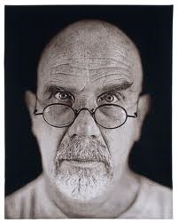
Chuck Close
Representational
A easily recognizable images of an object, person, or thing

Slide 4
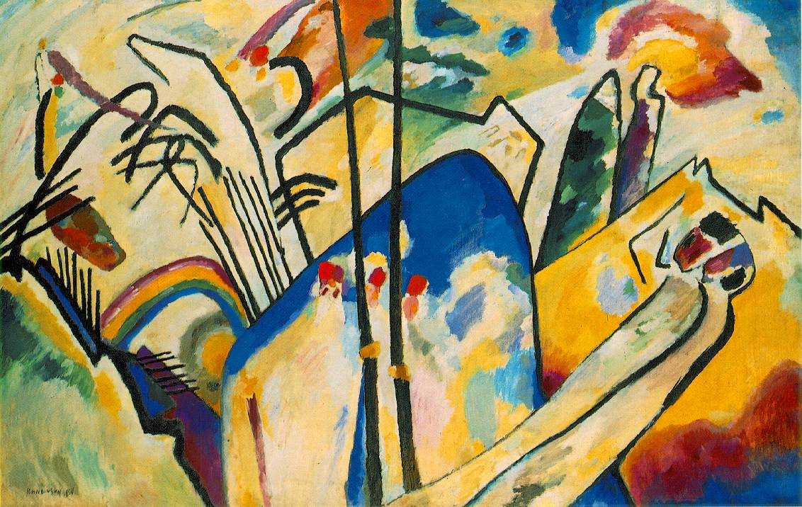
Kandinsky
Abstract
A non-lifelike representation of real world objects, people, or things.

Slide 5
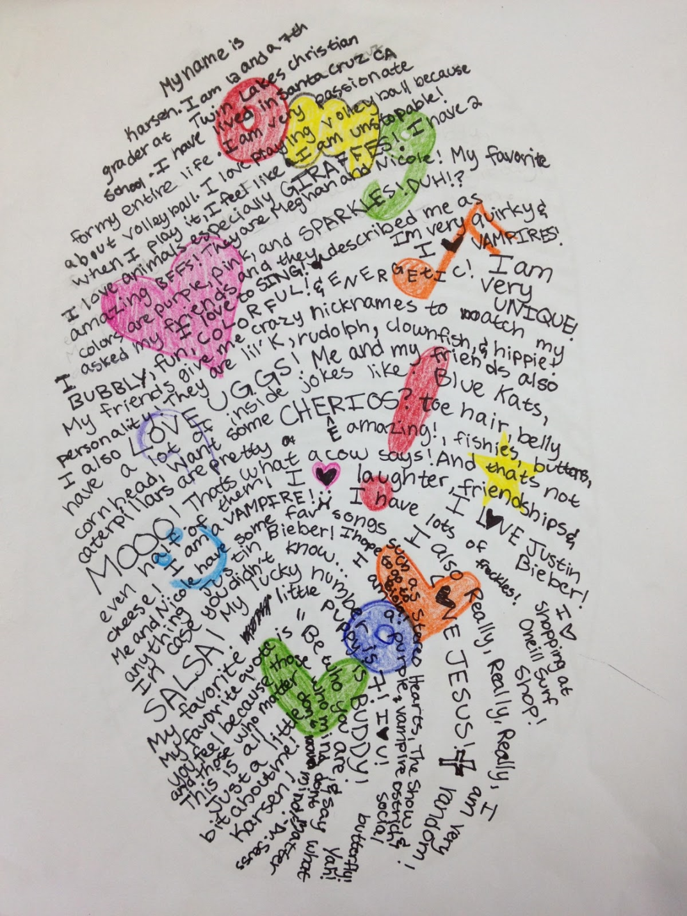
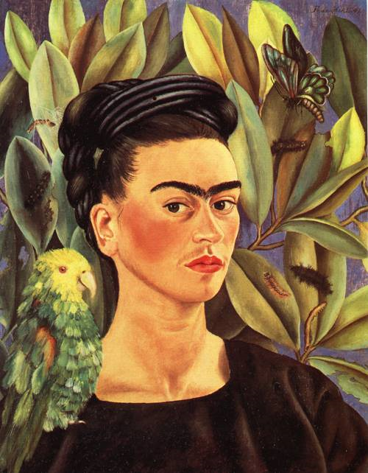
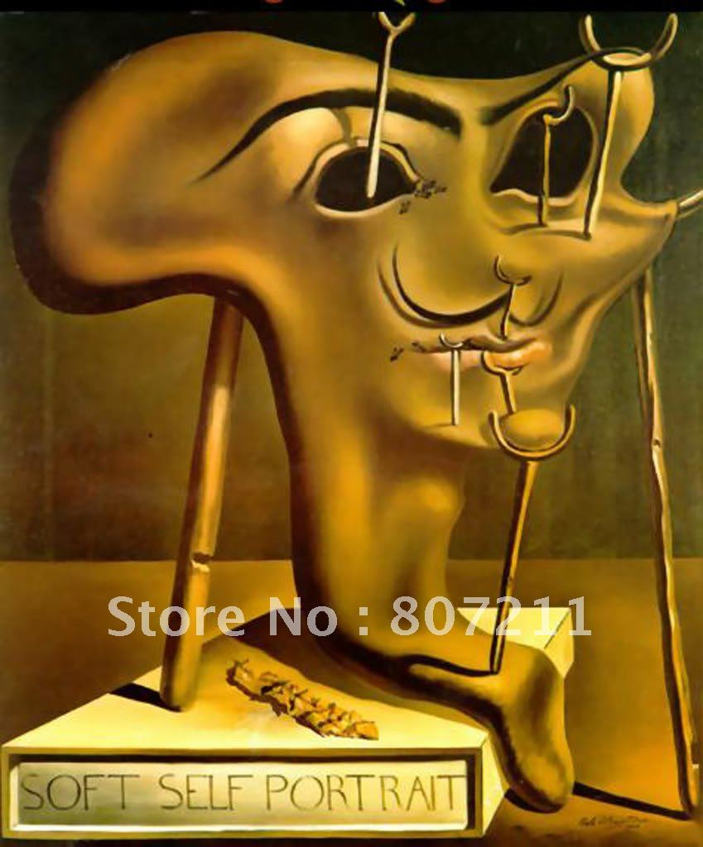
Abstract vs. Representational

Slide 6
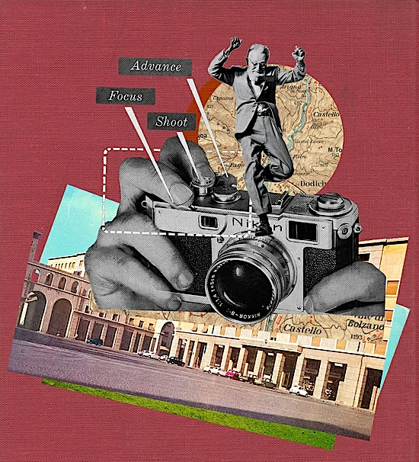
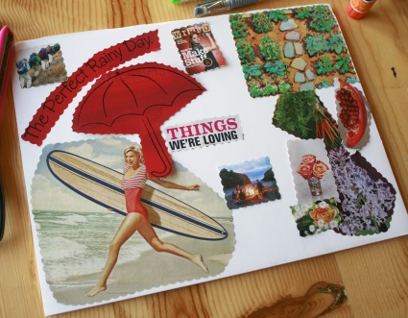
Collage
Exaggeration
Placement

Slide 7
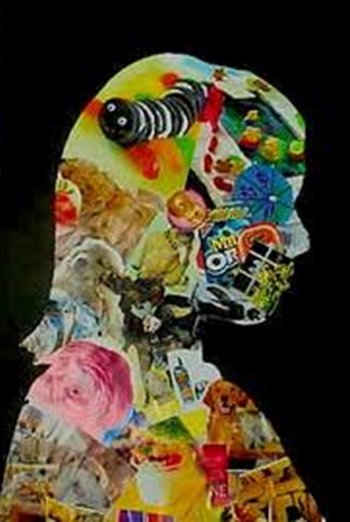
R- Artist
A- People you don’t know
F- Collage
T- Abstract self-portrait

Slide 8
Clean up
One person from each group will…
collect and return all magazines and usable materials back to the area they got them from.
collect all of the trash and scraps and throw it away and recycle an paper items.
put away all other materials such as scissors, markers, and colored pencils in table bins.
Then all students will put their sketchbooks in their cubbies and be seated and quiet with their completed artwork on the circle.

